Slide 1


Collaborative Efforts to Support Students with ADHD
Working with
Family
School
Community

Slide 2

Collaborative
Efforts
1. Family: creating a supportive environment
2. School: providing adaptive education
3. Community: integrating resources, promoting inclusion
4. A Sucessful Case of Tripartite Collaboration

Slide 3


Family -
Creating a Supportive Environment
Partnership with families requires shared aims and goals, building trust , mutual commitment and empathy.

Slide 4
Solution 1 - Parents Education and Training
Basic ADHD knowledge
Basic Management Techniques
Parents need to understand the basics of ADHD and recognize its potential
the impact of children
Train parents to use positive reinforcement to motivate their children's good behavior
Solution : Participate in seminars or classes (host by online organization, school and society) to know more about ADHD Period intervention and management strategy information
Provide skills training to enable parents to develop more effective communication and interaction strategies

Slide 5

Solution 2: Optimizing the Home Environment:
1, Create a structured and orderly living environment.
2, Reduce distractions, such as TV and phones.
Solution 3: Parent-Child Interaction and Communication:
1, Increase interactive time through shared reading, games, etc.
2, Listen to children's thoughts and establish a trusting relationship.

Slide 6


School
- Providing Adaptive Education
Through adaptive education
With planning and classroom adjustments, schools can effectively meet the unique learning needs of ADHD
students

Slide 7



Individualized Education Plan (IEP)
Individualized educational goals
Every ADHD student has different needs, and an individualized Education Plan (IEP) ensures that these differences are supported
1
Teachers work with parents to set specific learning goals, such as concentration and task completion
Provide necessary learning support and AIDS
Use specific learning tools and materials, such as diagrams or structured information, to help students understand the content
2
Implement positive behavior support systems, such as reward mechanisms
Establish clear classroom rules and behavior expectations

Slide 8
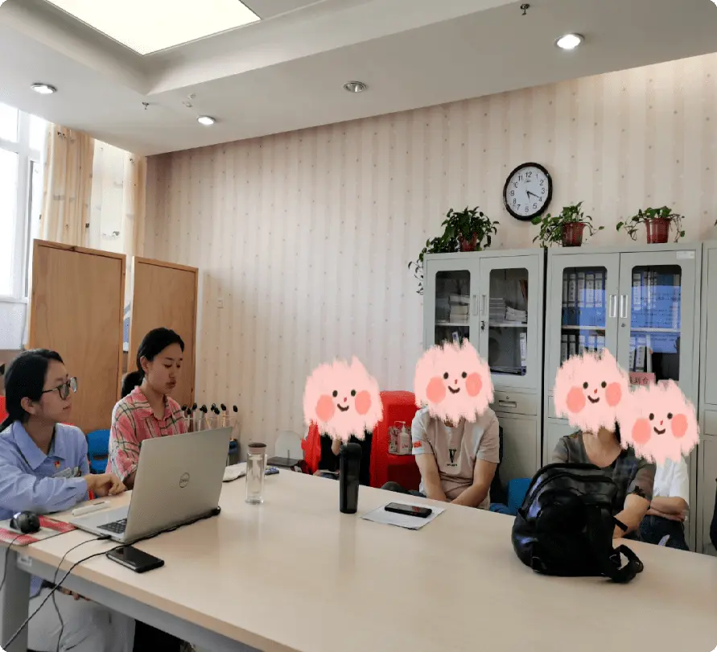


Community
- Integrating Resources
At the community level
Connecting multiple services and support systems is expected to enhance the well-being of ADHD students.

Slide 9



Community support and services
1, Provide professional services such as sensory integration training and psychological counseling
2. Organize social activities for ADHD students and their families
Role 1: Strengthen mutual assistance and communication among community members
Role 2: Provide ADHD students oppotunities to communicate and cooperate with other students

Slide 10

Education, Medical Care and Social Security Cooperation
To ensure that the health, education and well-being of students with ADHD are fully supported
●
●
Set up regular meetings to share the latest information and strategies with families and school

Slide 11

4. A Sucessful Case of
Tripartite Collaboration
The family-school - community cooperation model of ADHD promoted by Australian educational psychologist Dr. Andy Utley based on the MOXO attention assessment system

Slide 12
Background and Challenges
- In Australia
1. Clinical caution: psychiatrists are cautious about the prescription of ADHD drugs
2. Surging demand: After the COVID-19 epidemic, the public's awareness of ADHD has improved, but traditional assessment tools (such as DIVA-5 and BRIEF-2 questionnaires) have problems such as strong subjectivity and data fragmentation, which are difficult to meet the needs of home-school coordination.

Slide 13
Andy's team works with
schools, families, and healthcare facilities in community
1. School Adjustment of teaching strategy:
Based on MOXO data, the "segmental task method" was designed to break classroom tasks into 15-minute modules and embed dynamic rest segments
Teacher training:
to carry out the "attention friendly design class"workshop :(https://baike.baidu.com/item/%E5%B7%A5%E4%BD%9C%E5%9D%8A/10295906), to train teachers to use visual cues,
2. Home Behavior Management Toolkit:
Provides parents with customized solutions based on MOXO data, such as: For students with "time perception defects", it is recommended to use an hourglass timer to assist in job management; Designed the "calm corner + emotional card" intervention process for students with "weak impulse control".
3. Community resource integration Early Screening program: In partnership with Sydney Public schools, the MOXO test is included in the annual health check for students aged 7-12 years to achieve early identification of ADHD; Public action: In conjunction with ADHD Australia, community talks were held to dispel the stigma of "ADHD = lazy" with the MOXO data case.
Results:
promoted globally through the Australian Medical Technology Conference (AusMedtech) in 2025
scientific and effective recognized by multinational pharmaceutical companies (such as Medtronic) and educational institutions

